Slide 1


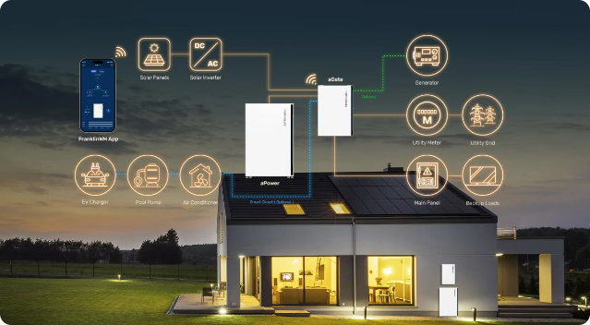
Home Energy Management System
Home energy management is a critical aspect of modern life. It involves optimizing the use of energy resources within a residential setting, aiming to reduce consumption, minimize costs, and improve sustainability.

Slide 2

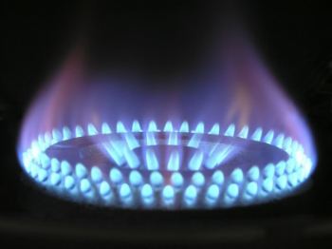
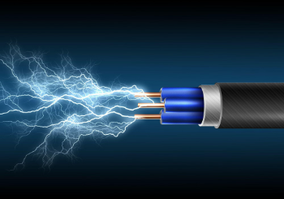



Home Energy Management Components
Gas & Fire
Electricity
1
2
3
4
Water
AI

Slide 3

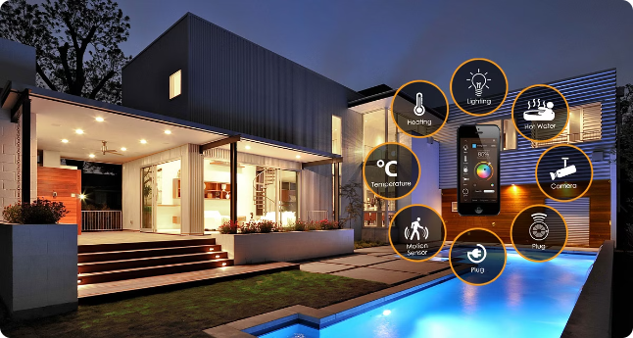
Gas and Fire
Managing fire and gas consumption in smart homes involves using advanced technologies to ensure safety and efficiency. Through the technology of automatic control of the system, high quality service is provided to the customer by handling it in every possible way to avoid any emergency situation that may occur in the house.

Slide 4


Gas Consumption
Automated Monitoring
Backup Biogas
The system continuously monitors gas consumption and automatically detects any reductions in supply.
When gas supply is reduced, the system automatically switches to biogas as a substitute without disrupting the home's operation.
Voice Control
Homeowners can control gas appliances through voice commands, providing convenient and on-demand access.

Slide 5

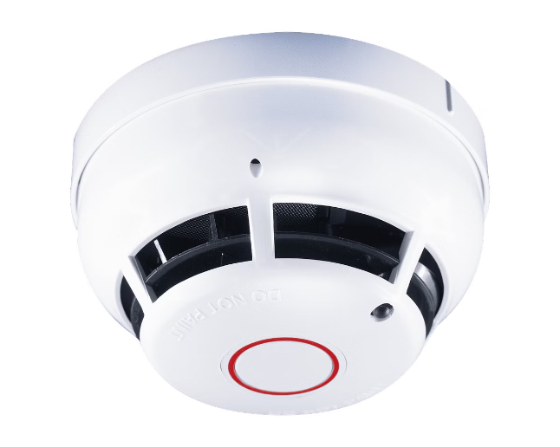
Fire and Gas Management
1
Sensor Monitoring
2
Automated Shutoff
Various sensors, including pressure, temperature, and fire detectors, continuously monitor activities in the home.
In the event of a gas leak or fire, the system automatically shuts off gas and electricity supplies to prevent further damage.
3
Safety Protocols
The system follows pre-programmed safety protocols to handle emergencies and ensure the well-being of the occupants.

Slide 6





Emergency Response
Fire Detection
The system uses image processing to analyze CCTV footage and detect the presence of flames.
Threat Assessment
Based on the nature of the flame, the system determines whether the situation is controllable or poses a serious danger.
Automated Response
If a serious fire is detected, the system automatically shuts off gas and electricity, and triggers water from taps to extinguish the fire.

Slide 7


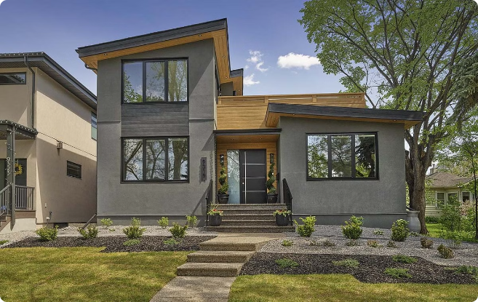


Efficiency and Optimization
Data Analysis
The system collects and analyzes data on energy consumption to identify opportunities for optimization.
Automated Control
The system automatically adjusts settings to optimize energy usage and minimize waste.
Scheduling
Homeowners can set schedules for appliances and utilities to improve efficiency.

Slide 8

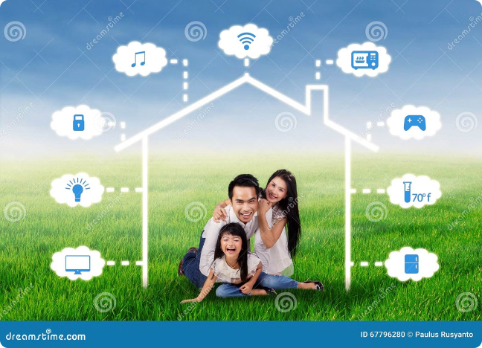
Benefits of Integrated Home Energy Management
1
Safety
Enhances the safety of the home by quickly detecting and responding to emergencies.
2
Efficiency
Optimizes energy and resource usage to reduce costs and environmental impact.
3
Convenience
Provides homeowners with intuitive control and automation for a seamless living experience.

Slide 9

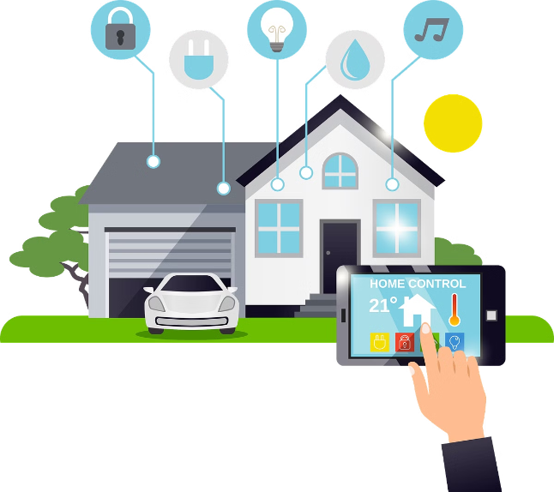
Conclusion
An integrated home energy management system leverages advanced technologies to create a safer, more efficient, and more convenient living environment for homeowners. By monitoring and optimizing the use of electricity, gas, and water, the system ensures the well-being of the occupants and reduces the environmental impact of the home.

Slide 10
Water
Our advanced water storage and distribution systems utilize cutting-edge technology to optimize water usage, conserve precious natural resources, and minimize electricity consumption. This integrated solution provides granular control, enabling adjustments to irrigation schedules and rapid leak detection for a more sustainable and efficient household water management approach.

Slide 11


Water Management
The water management component of the home energy system employs innovative leak detection sensors placed at strategic locations. These sensors continuously monitor for water leaks and promptly notify the control unit to shut off the water supply, preventing costly water damage.

Slide 12
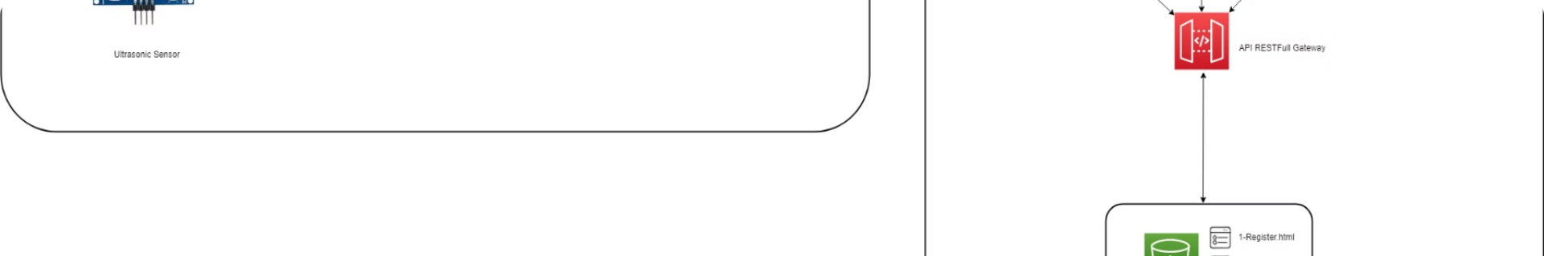
Smart Water Control
Leak Detection
User Notifications
Sensors constantly monitor for water leaks and alert the control unit.
The system sends alerts to the user's smartphone or web app about the detected leak and actions taken.
1
2
3
Automated Shut-Off
The control unit signals the smart shut-off valve to immediately stop water flow when a leak is detected.

Slide 13
Integrated Monitoring
Water Usage Tracking
Irrigation Optimization
Leak Prevention
The system tracks water consumption patterns and provides detailed usage reports to help users identify areas for improvement.
The system can be programmed to automatically adjust irrigation schedules based on weather conditions and plant needs, reducing water waste.
Advanced analytics can predict potential leaks, allowing users to take proactive measures to maintain their plumbing system and avoid costly damages.

Slide 14

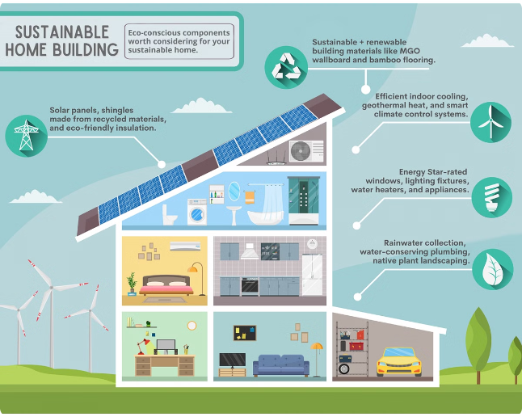
Benefits of the System
1
Water Conservation
2
Cost Savings
Reduces water consumption and waste through intelligent monitoring and control.
Prevents water leaks and optimizes usage, leading to lower utility bills.
3
Sustainability
4
Convenience
Promotes environmentally responsible practices by minimizing the household's water footprint.
Provides real-time data and remote access, allowing users to easily manage their water resources.

Slide 15



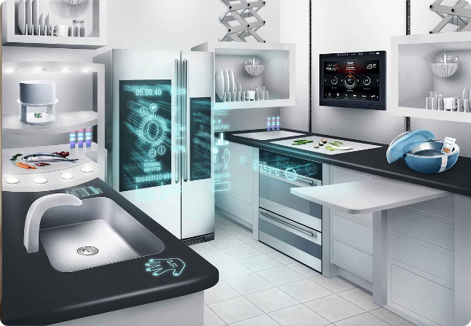


Conclusion
Water Management
Energy Efficiency
Comprehensive water monitoring and control to optimize usage and prevent leaks.
Reduced energy consumption associated with water heating and pumping.
Cost Savings
Sustainability
Lower utility bills and maintenance costs through proactive management.
Contributes to a more environmentally responsible and resource-efficient household.

Slide 16
Electricity
Electricity management in homes is becoming increasingly important as we strive for greater energy efficiency and cost savings. Managing electricity effectively involves monitoring and controlling electrical devices and appliances to ensure they are used only when needed. The integration of smart technologies and IoT devices into home energy systems has revolutionized how we manage electricity, making it possible to automate and optimize usage in real-time.

Slide 17

Electricity: Innovative Features
Automated Shut-Off
The control unit processes sensor inputs and manages the smart switches/plugs to intelligently control electrical devices based on occupancy and door status. This includes automated shut-off of devices when the home is empty.
Occupancy Detection
Motion sensors in each room detect human presence, ensuring lights and devices are only active when needed.
1
2
3
Main Door Monitoring
The door sensor tracks the status of the main entrance, allowing the system to automatically shut off lights and equipment when the home is unoccupied.

Slide 18

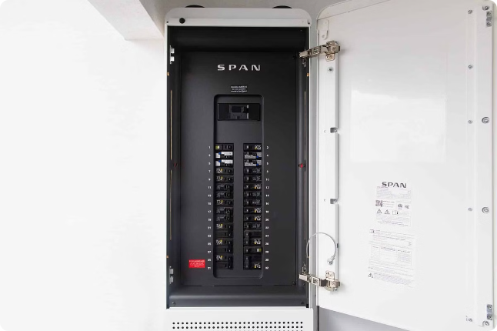
Electricity Management
1
Motion Sensors
2
Door Sensor
Detect occupancy to automatically control lighting and electrical devices.
Monitor the main door status to optimize energy usage when the home is unoccupied.
3
Smart Switches/Plugs
4
Central Control Unit
Processes sensor data and manages the smart switches/plugs to automate energy-saving actions.
Remotely control and monitor the energy consumption of individual electrical devices.

Slide 19
Electricity: System Components
Motion Sensors
Door Sensor
Smart Switches/Plugs
Data Processing Unit
Detect occupancy in each room to automate lighting and device control.
Monitor the main entrance to optimize energy usage when the home is unoccupied.
Collects and analyzes data from the sensors to intelligently manage the home's electricity usage.
Remotely control and monitor the energy consumption of individual electrical devices.

Slide 20

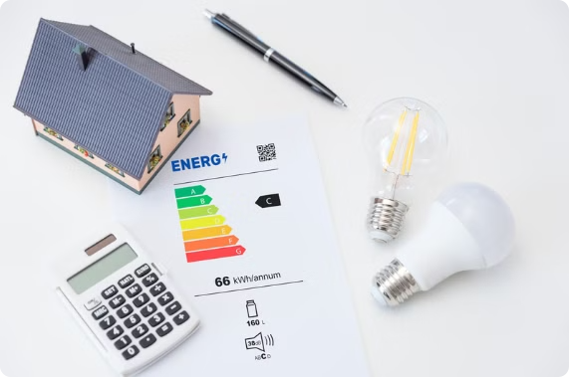
System Benefits
Energy Savings
Convenience
The automated control of lights and devices based on occupancy and door status can significantly reduce electricity consumption and costs.
The remote access and control features allow homeowners to manage their energy usage from anywhere, providing added flexibility and control.
Sustainability
Customization
By optimizing energy consumption, the IHEMS contributes to environmental conservation and reduced carbon footprint.
The system can be tailored to the unique needs and preferences of each household, ensuring optimal energy management.

Slide 21

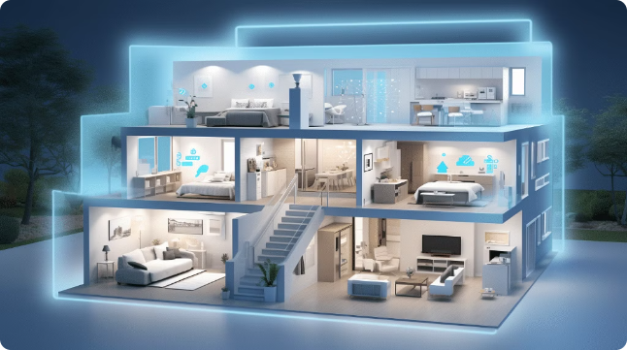
Conclusion
The Home Energy Management System provides a comprehensive and intelligent solution for managing a home's electricity, gas, and water usage. By integrating advanced IoT technologies, the system offers unparalleled energy savings, convenience, and environmental sustainability. As homeowners increasingly prioritize energy efficiency and conservation, the IHEMS stands as a transformative tool for creating a more sustainable future.

Slide 22

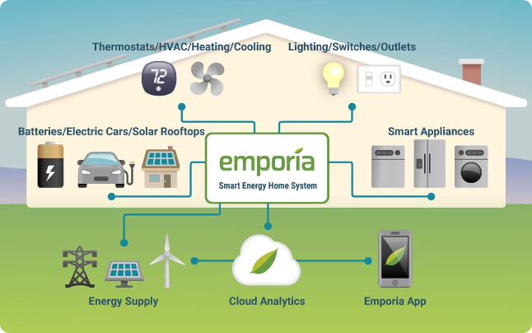
AI : Introduction
Take control of rising utility costs and your environmental impact with this cutting-edge AI-powered system. Discover the remarkable components, game-changing benefits, and seamless user experience that transform your home into an efficient, money-saving home.

Slide 23
Key Components
Electricity
Gas
Water
Monitor and manage electricity usage in the home, identifying areas for optimization.
Analyze gas consumption patterns and provide recommendations for efficient usage.
Track water usage and detect leaks or inefficient practices to conserve this valuable resource.

Slide 24

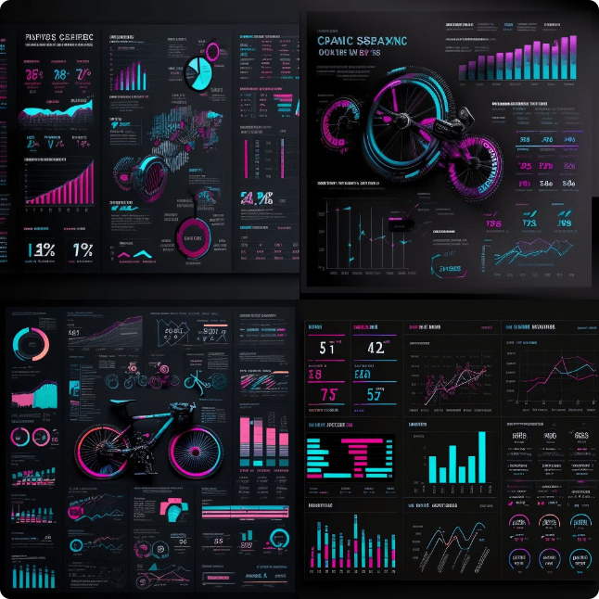
AI-Powered Optimization
1
Blackbox Software
2
Data Analytics
A robust database system to store sensor data, usage patterns, and system logs for long-term analysis.
Dashboards and reports provide real-time insights and efficiency analysis over time.
3
Security
Secure user authentication and data integrity measures to protect the system.

Slide 25

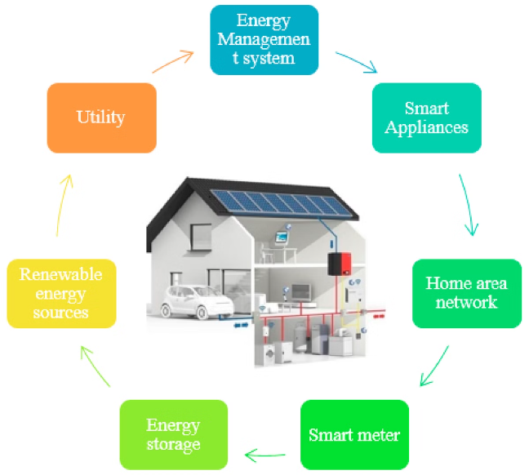
Home Energy Management Overview
1
Energy Monitoring
Collect real-time data on electricity, gas, and water usage across the home.
2
Predictive Analytics
Use AI to analyze usage patterns and anticipate future energy demands.
3
Optimization
Intelligently adjust resource consumption to improve efficiency and reduce costs.

Slide 26

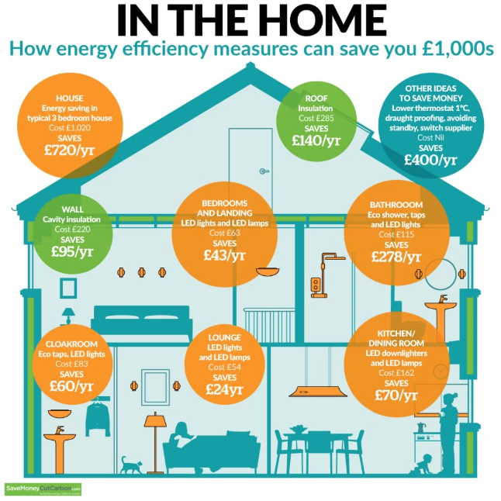



Benefits of the System
Cost Savings
Energy Efficiency
Reduce energy bills through optimized resource usage and proactive maintenance.
Minimize waste and maximize the use of electricity, gas, and water in the home.
Sustainability
Convenience
Promote eco-friendly practices and reduce the home's environmental impact.
Provide a user-friendly interface to monitor and control home energy usage.

Slide 27


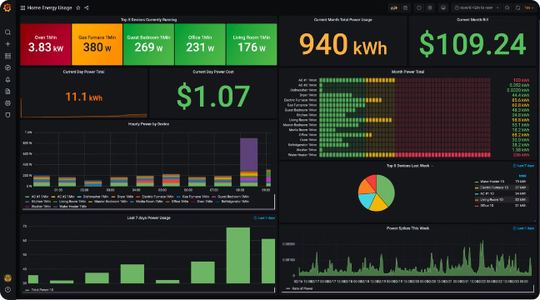


Enhancing the User Experience
Personalized Recommendations
The system provides tailored suggestions based on the homeowner's usage patterns and preferences.
Intuitive Dashboard
A visually appealing dashboard displays real-time data and highlights opportunities for improvement.
Cost Transparency
Detailed reporting allows homeowners to understand their energy expenditures and track savings over time.

Slide 28

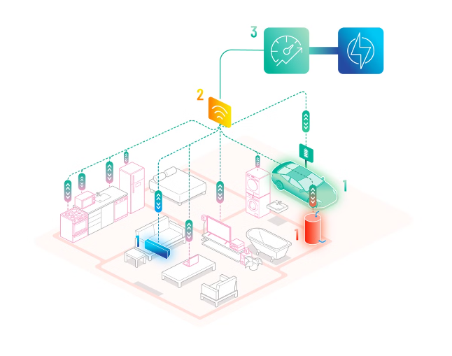
Conclusion
1
Comprehensive Solution
2
Innovative AI Technology
The Home Energy Management System provides a holistic approach to optimizing resource usage and reducing costs.
Advanced analytics and predictive capabilities enable intelligent, data-driven decision-making for energy efficiency.
3
Enhanced User Experience
Intuitive dashboards, personalized recommendations, and cost transparency empower homeowners to take control of their energy usage.

Slide 29

END
Effective home energy management is crucial for a sustainable future. By integrating smart technologies, optimizing energy usage, and adopting renewable sources, we can create more efficient and environmentally conscious homes.

